Slide 1
Hands On Exercises for
Understanding of Team Formation & Logbook
Gujarat Technological University
Centre for Industrial Design
- Asst. Prof. Jaimin Dave (GTU)

Slide 2
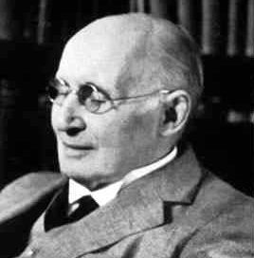
Great dreamers' dreams are never fulfilled, they are always transcended
-Alfred North Whitehead

Slide 3
Type of Team Formation
Faculty pick teams
Student pick teams
Completely random selection
A hybrid teams (Combination of above all)

Slide 4
Random Selection
It is quick selection will not take time.
When to do Random Selection?
Project is Less Thoughtful
For short term discussion
Methods to do Random(arbitrary) selection
  Write name in chit and through in bowl then pick up the chit
  Same letter for starting of their name
  By enrolment number
  Cards or number allocation

Slide 5
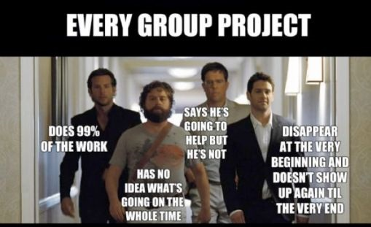
What Happen when student select team by themselves?

Slide 6

What Happen when Faculty select team?

Slide 7
How to Form hybrid team?
Categorized students of class as per their competencies, skills and interest
Form an intermediate group
Ask student to make their final Team

Slide 8
Qualities to be search
Project Organiser (who manages all the project)
An analyser (who can do analysis of data)
Stream wise technical Skill person (Mechanical, Electronics, Software and etc.)
Concept generator (Person who visualise the Idea or solution for the problem)
  -

Slide 9
Finding process for any quality
1.Give students a quiz with 3 questions rating 1 – 5
  Familiarity with topic (How many papers have you written)
  Interest with topic (Rate how much you enjoy writing)
2.Collect answers and total responses (#/15)
3.Put responses in order at the front (privately)

Slide 10
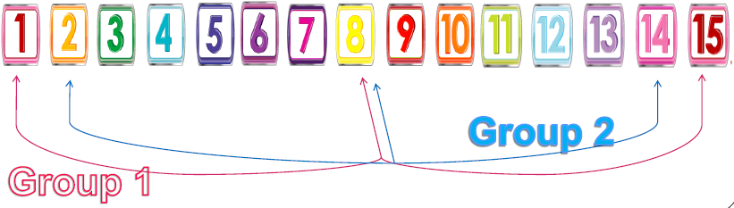
Forming mini Group
4.Match up high low (and in between abilities)
Joined any two abilities. (Like Analyser & Project Manager) in whole class

Slide 11
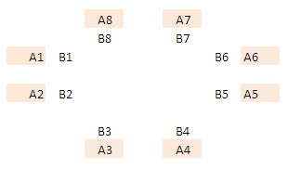
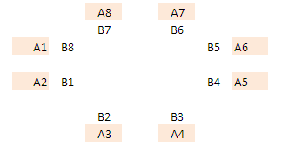
Ask student to make final Team
Now As you(Faculty) has made team A(Analyser and Project Manager) and team B(Technical and Concept Idetor)
Ask them to take interview of each team for 5-10 minutes.
Let ask them to have list in order with whom they want to form team. (From high priority to less).

Slide 12

What Happen when hybrid selection is being done?

Slide 13
Let’s have exercise based on it.

Slide 14
Requirement of Team Formation
Teach each other
Practice communication, teamwork, project management skills
Work on higher-order assignments
Expand network & meet new people
Learn readings better (discussion groups)
Simulate real-life work environment

Slide 15
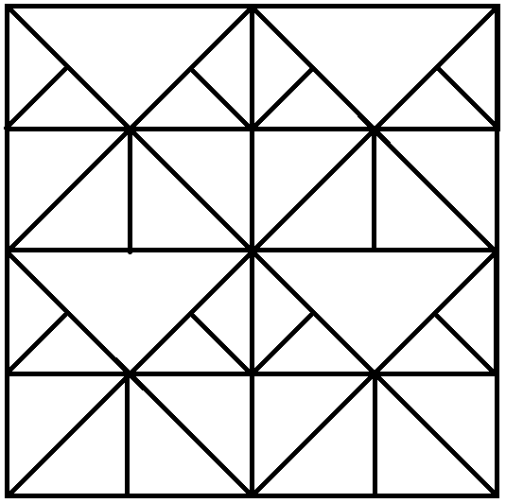
Teaching Each Other
1
2
3
4

Slide 16
Work on higher-order assignments
Pen
Eraser
Ball
Bridge
Coat
Beg
Car
Diamond
Maze
File
Burger
Water
Grape
Rose
England
Electricity
Games of thrones
Jurassic park
Contra
Transistor
Spring
Whale
Trumpet
Black hole
Grass cutter
Hovercraft

Slide 17
Work on higher-order assignments
Pen
Eraser
Ball
Bridge
Coat
Beg
Car
Diamond
Maze
File
Burger
Water
Grape
Rose
England
Electricity
Games of thrones
Jurassic park
Contra
Transistor
Spring
Whale
Trumpet
Black hole
Grass cutter
Hovercraft

Slide 18
Expand network & meet new people
Find people who are having same birthdate or same birthweek
List his/her name, Phone number, email id
What will be the advantage?

Slide 19
Learn readings better (discussion)
There is no such thing as an uninteresting natural number.
Proof by Contradiction: Assume that you have a non-empty set of natural numbers that are not interesting. Due to the well-ordered property of the natural numbers, there must be some smallest number in the set of not interesting numbers. Being the smallest number of a set one might consider not interesting makes that number interesting. Since the numbers in this set were defined as not interesting, we have reached a contradiction because this smallest number cannot be both interesting and uninteresting. Therefore the set of uninteresting numbers must be empty, proving there is no such thing as an uninteresting number.
3
6
5
4
2

Slide 20
Simulate real-life work environment
From each group only one member is allow to move and he has too change position of table in terms of distance.(minimum 20 cm)
From each group only two member: count number of bars in window of this room in one minute

Slide 21
That’s all About Team

Slide 22
Log Book

Slide 23
What are the quality Design Teacher should have?
All of you divide in three person team
List idea by yourself then compare with other team members
Discuss with them about the idea.
Write idea in front of desk.

Slide 24
Why Did We Do That?
People who are quiet get to provide feedback
Many responses at once
Anonymous responses
Shows student understand
Shows trends in common thinking

Slide 25
New Exercise
On the top of the design sheet,
Write the number of the problem statement
Write your full name
Read the problem statement.
Team assignment (quiet)
Give solution for the problem
3
1
6
5
4
2

Slide 26
Bring the problem statements and the design sheet to the front of the room.
Put the design sheets in stacks of A, B, and C
Take a sheet back with you:
If you had A, take a B.
If you had B, take a C.
If you had C, take an A.

Slide 27
Define the different analyses and tests that are required to ensure the design is successful.
In 5 minutes
3
6
5
4
2

Slide 28
Bring the design sheet to the front of the room & put in stacks of A, B, and C
Take a sheet back with you:
If you just brought back A, take a B.
If you just brought back B, take a C.
If you just brought back C, take an A.

Slide 29
Write what you think the problem statement is?
5 minutes
3
1
6
5
4
2

Slide 30
Problem
Problem 1
Problem 2
Problem 3
In my jewellery box, my necklaces are all constantly getting tangled and I spend too much time trying to get the little knots out of the chains. I want a device that is easy to travel with and can handle a varying number of necklaces, pendants, and types of chains.
When I teach, I find I sometimes go over the time limit, forget to bring a marker or chalk for the board, or forget to hand back assignments. Quite the absent-minded professor, help me by designing something to ensure I stay organized
I like bicycling to the gym after work. However, it’s hard to transport my work-out clothes, a towel, shampoo, and my laptop. Design something to protect my laptop from the wet towel and clothes after working out, and make it easy to transport on a bicycle

Slide 31
Analysis
Look at the sheet in front of you.
How close was your problem statement to the actual one?
Would the product meet the objective of your problem statement?
Would the analysis and test help determine whether or not the problem was solved?

Slide 32
Why Did We Do That?
This was actually about logbooks but students can’t know that

Slide 33
Why keep a logbook?
An engineering logbook is a personal/professional reference about project learning and results.
These records may become necessary to provide a history of the design if there is a turnover in staff, if patent applications are made, or in the case of legal action where the demonstration of professional practices is necessary.
Monitor and control where you invest your time,
Learn and apply the best practices for your profession
Regularly take time to learn from successes and failures

Slide 34
Log Book Specification
Think of the logbook as a design diary.
Contain all sketches, notes and decisions pertaining to the design/project work.
Hard bound notebook, so pages can’t be added/removed (not spiral one)
Write in ink. Don’t erase.
Date and sign every page
Fill consecutive pages (no leftover/blank pages)
Keep up to date (with timely sign of guide)
Include everything you contribute to ... good, bad, and ugly

Slide 35
What should be there in Logbook?
Sketches/doodling
Customer needs or requirements
Class notes
Project objectives
Meeting notes
Action Items
Half-baked Ideas
Math calculations
Work-in-progress
Design alternatives
Vendor notes
Research findings
Sources of ideas
Evaluation of data/results
Design reviews
Decision criteria
Design process
Rationale for decisions
Project reflections
Professional development

Slide 36
Example (Logbook Entry for a Meeting )
Name of speaker, attendees
What they said/discussed
What that means to you/your project,
Anything you need to research or learn more as a result (words you didn’t understand, ideas you need to further look into).

Slide 37
If you just finished… Ask yourself…
A meeting
  What were the main outcomes of the meeting?
  Was the meeting productive, and why?
  What are your personal action items before the next meeting?
  Is the team heading in the right direction?
Brainstorming,
  Which ideas seem most feasible, and why?
  Are there enough good ideas?
  How could better ideas be developed based on this session?
Engineering Analysis,
  What were the governing equations?
  What were the most important findings?
  What do the results mean and how should they be applied?

Slide 38
If you just finished… Ask yourself…
Visualization, (by hand or in CAD)
  What are the major features/discoveries and why are these significant?
  What was learned about the problem or solution possibilities?
  What problems were resolved and what still needs to be addressed?
  How does this piece integrate with the whole?
An internet search
  What key information did I find? How does it help achieve the project objectives?
  Are there other sources that should be pursued?
  –What new questions were generated?

Slide 39
Thank You
Should you have any query, kindly write us at: design@gtu.edu.in
For more information, kindly visit us at: http://de.gtu.ac.in/

